Slide 1
EE 295
TechWriting-Engineering Ethics
Sep 10, 2019
Room E339
Tom Wrappe
EE Lecturer

Slide 2
Agenda
IEEE Code of Ethics Overview
Midterm Paper Assignment and Discussion
Upcoming Out of Class Writing Assignments

Slide 3
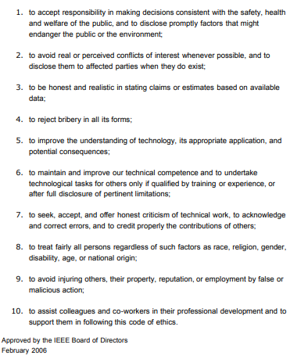
IEEE Code of Ethics

Slide 4
Semester Major Items…..(subject to modification)
 | Mid Term | Resume | Final Paper | Final Presentation (slides )
Topic Paragraph | 9.5.19
Topic Proposed | 9.12.19 |  | 10.3.19
Topic Final | 9.19.19 |  | 10.10.19
Outline/ Abstract | 9.26.19 |  | 10.31.19
Research | 10.1.19 | 10.24.19 (Class) | 10.15.19
Draft Complete | 10.10.19 |  | 11.7.19 | 11.19.19
Final Submit | 10.22.19 | 11.14.19 | 11.26.19 | 12.3.19
Final Presentation | NA | NA | NA | 12.17.19 (Sect 1) 12.12.19 (Sect 2)

Slide 5
And So It Begins…..
The Types of Engineering Writing you will encounter:
A proposal/Business Plan – I have an idea on how to:
a. Decrease the power consumption …
b. Increase the applications …
A Research Report – Based in your focus area…
a. Find out how companies are…
b. What is the State of the Art for….
c. Research Sources
A Promotion Presentation-Why someone should listen…
a. Writeup
b. Live presentation in 3 min

Slide 6
First 5 Page Report (Midterm)
The First 5 Page Report will be a Proposal/Business Plan focused on adding a new product to the product line or entering a new area
-Target audience is “your boss” who wants to get the project approved
-Arm her/him with the convincing approach and supporting facts to get the project moving
-Topic areas suggested, but specific paper topic should be put forth by the student (BY Thu, Feb 15—One paragraph describing the proposed product area. Bring to class)
Submit topic writeup (600 words) by Sep 12
Develop interim deliverables per schedule (weekly)
Scheduled final submission is by Oct 22

Slide 7
First 5 page Proposal A Concise Version of a Business Plan
(1) The Abstract
One concise paragraph that provides an overview of the contents of the paper along with key words. The objective of the abstract is to attract readers to the paper.
(2)The Executive Summary
This is a 1 or 2 Paragraph (maximum) section that summarizes the purpose and conclusions of the report
(3) The Product Description/Proposed Business Concept
What is the proposed product and how will this proposed process/part/system enhance the present product of the company (existing or startup)?

Slide 8
“5 Pager” Proposal
(4) Research & Analysis
A) Market Analysis: Will this increase the market sales of the present product or address a new market (what size?)?
B) Product Analysis: Will it increase the Quality or Functionality of the present product? What is the “state of the art” of the pertinent technology? This is where references are essential

Slide 9
“5 Pager” Proposal
(5) Finance & Economics
How much money will the venture require (structure is key: Development, Product, other investments)?
(6) Management Team
How will the team contribute to the success of the business? (In terms of their background and skills).
(7) A brief summary of the Risks & Assumptions (Tech, Market, other)

Slide 10
“5 Pager” Proposal
(8) Conclusions (Positive development for the company?)
(9) Recommendations (Go forward?)

Slide 11
A Progressive Process
Step | Due Weeks from Start | Notes
Discuss a topic | Start | 1 paragraph on end product
Propose a topic/ company | Start | 600 words overview of the paper
Abstract/Outline | 2 weeks | Skeleton of the paper
Research Deliverable | 3weeks | Support Elements
Draft | 4 weeks | Complete paper form, but needing edit for final
Final Submission | 5 weeks | Final product

Slide 12
Midterm Topic Areas
Networks, AI, wireless, IC technology, drones, driverless cars, robotics, telehealth are all areas of tech investment today
Examples:
-A wireless Chipset company that has large market share in 4G proposes a 5G Project (Nvidia, Intel, Qualcomm, Nvidia)
-An established Networking company proposes adding extensions to its product line
-A GPS company that sells navigation units considers expanding to address autonomous cars
-Network company considers adding big data services by adding analytics to their process
A startup team out of Google wants to build a new generation of driverless cars

Slide 13
For Sep 12
600 words
Proposed Topic for Business Proposal
Industry Area (ie, semi, networking, …)
Company (chosen existing company or newco)
Product area (high level description)
Why you chose the topic and why you thing it is a good one
Be thinking about the research on market, company, technology that is needed
How will you budget your 5-6 pages between the key elements of the outline?

Slide 14
Tech Descriptive Writing: Blockchain Description

Slide 15
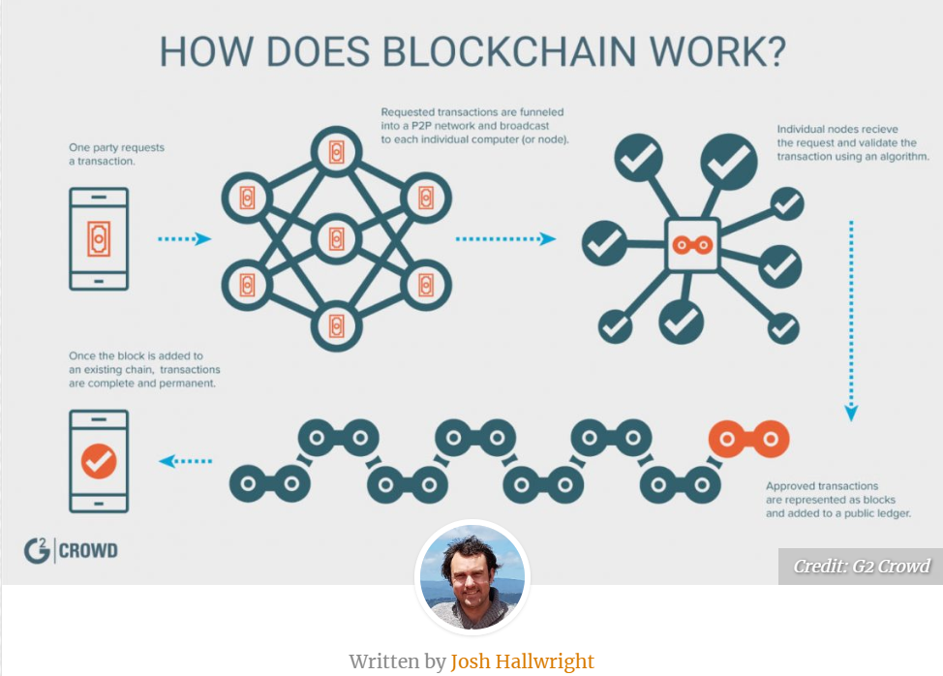

Slide 16
Blockchain Discussion Items
Report Type? Product/Technology Description
Key conclusions of report:
What is Blockchain (BC) and why is it important?
How does BC work?
What can BC do?

Slide 17
Out of Class Writing Assignment #2
Due, Thu, Sep 19 @11:59pm
FOLLOW ALL INSTRUCTIONS
-Write an informational report to describe "What is Blockchain?" and submit via Canvas
1. 500-600 words (approx 2 pages #12 font double spaced). NO PICTURES, JUST TEXT DESCRIPTION. The goal is that the audience (class members) can understand and describe what Blockchain is and what the technology can do based on your description.
2. Provide a title followed by 3 or 4 paragraphs using the following high level outline:
a. Summary
b. Body
c. Conclusion
3. As a condition of grading, supply the following (on a page following the assignment)
a. Word count
b. Underline or highlight the topic sentence of each paragraph in the paper
c. Provide your check of the EE295 key elements by filling out and including certification of 1. No personal pronouns, 2. No use of passive voice, 3. no use of "very", 4. All paragraphs complete and at least 3 sentences. Provide a table with these four rows and a column noting your compliance to each element.

Slide 18
Video
Blockchain Operation

Slide 19
In Class Writing Exercise #1
30 minutes max…

Slide 20
Plagiarism and Teams
Pete works for CISCO and is given his first major project from his Manager. The project is a team effort and one week before the project is due, Pete finds out that Valeria has chosen to “copy and paste” a majority of her “background and introduction”. Pete confronts Valeria and asks her to redo her paper without plagiarizing, but Valeria claims she is too busy . She assures Pete that their Manager will never discover the plagiarism, and that, if he does, that she will take complete blame for it.
Pete finds himself in an extremely uncomfortable position. He feels partly responsible for the plagiarism that he discovered; however, Valeria claims she will take all of the blame.
A. What should Pete do?
B. Should he talk to the manager?

Slide 21
Plagiarism In Class Assignment (30 min)
Write a 200-300 word paper to describe what Pete should do in this situation.
Use your 6 step process to prepare (do not just start writing. Plan out your work)
Who is the audience?
Key thoughts on the issues
Structure your work before writing
Develop your structure (Intro, body with support, conclusion)
Remember to incorporate the appropriate grammar items
No personal pronouns—”I, we, it, they, etc”
Avoid passive voice
Well structured paragraphs with ONE topic sentence per..
UNDERLINE EACH TOPIC SENTENCE IN THE PAPER
Concise, simple statements with good flow (300 words = 1 page)
Write Name and ID number on top of sheet and turn in

